Slide 1
Database Design Theory –
Normal Forms
CSC424
Lecture #10
Prof. Zhanyang Zhang

Slide 2
Multivalued Dependencies
There are database schemas in BCNF that do not seem to be sufficiently normalized
Consider a database
classes(course, teacher, book)
such that (c,t,b) ∈ classes means that t is qualified to teach c, and b is a required textbook for c
The database is supposed to list for each course the set of teachers any one of which can be the course’s instructor, and the set of books, all of which are required for the course (no matter who teaches it).

Slide 3
Multivalued Dependencies (Cont.)
course
teacher
book
database
database
database
database
database
database
operating systems
operating systems
operating systems
operating systems
Avi
Avi
Hank
Hank
Sudarshan
Sudarshan
Avi
Avi
Jim
Jim
DB Concepts
Ullman
DB Concepts
Ullman
DB Concepts
Ullman
OS Concepts
Shaw
OS Concepts
Shaw
There are no non-trivial functional dependencies and therefore the relation is in BCNF
Insertion anomalies – i.e., if Sara is a new teacher that can teach database, two tuples need to be inserted
(database, Sara, DB Concepts)
(database, Sara, Ullman)

Slide 4
Multivalued Dependencies (Cont.)
Therefore, it is better to decompose classes into:
course
teacher
database
database
database
operating systems
operating systems
Avi
Hank
Sudarshan
Avi
Jim
teaches
course
book
database
database
operating systems
operating systems
DB Concepts
Ullman
OS Concepts
Shaw
text
We shall see that these two relations are in Fourth Normal Form (4NF)

Slide 5
Multivalued Dependencies (MVDs)
Let R be a relation schema and let α ⊆ R and β ⊆ R. The multi-valued dependency
α →→ β
holds on R if in any legal relation r(R), for all pairs for tuples t₁ and t₂ in r such that t₁[α] = t₂ [α], there exist tuples t₃ and t₄ in r such that:
t₁[α] = t₂ [α] = t₃ [α] t₄ [α]
t₃[β] = t₁ [β]
t₃[R – β] = t₂[R – β]
t₄ [β] = t₂[β]
t₄[R – β] = t₁[R – β]

Slide 6
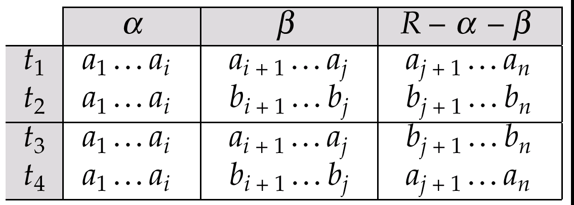
MVD (Cont.)
Tabular representation of α →→ β

Slide 7
Example
Let R be a relation schema with a set of attributes that are partitioned into 3 nonempty subsets.
Y, Z, W
We say that Y →→ Z (Y multidetermines Z)
if and only if for all possible relations r(R)
< y₁, z₁, w₁ > ∈ r and < y₂, z₂, w₂ > ∈ r
then
< y₁, z₁, w₂ > ∈ r and < y₂, z₂, w₁ > ∈ r
Note that since the behavior of Z and W are identical it follows that Y →→ Z if Y →→ W

Slide 8
Example (Cont.)
In our example:
course →→ teacher
course →→ book
The above formal definition is supposed to formalize the notion that given a particular value of Y (course) it has associated with it a set of values of Z (teacher) and a set of values of W (book), and these two sets are in some sense independent of each other.
Note:
  If Y → Z then Y →→ Z
  Indeed we have (in above notation) Z₁ = Z₂
  The claim follows.

Slide 9
Use of Multivalued Dependencies
We use multivalued dependencies in two ways:
  1. To test relations to determine whether they are legal under a given set of functional and multivalued dependencies
  2. To specify constraints on the set of legal relations. We shall thus concern ourselves only with relations that satisfy a given set of functional and multivalued dependencies.
If a relation r fails to satisfy a given multivalued dependency, we can construct a relations r′ that does satisfy the multivalued dependency by adding tuples to r.

Slide 10
Fourth Normal Form
A relation schema R is in 4NF with respect to a set D of functional and multivalued dependencies if for all multivalued dependencies in D⁺ of the form α →→ β, where α ⊆ R and β ⊆ R, at least one of the following hold:
  α →→ β is trivial (i.e., β ⊆ α or α ∪ β = R)
  α is a superkey for schema R
If a relation is in 4NF it is in BCNF

Slide 11
Overall Database Design Process
We have assumed schema R is given
  R could have been generated when converting E-R diagram to a set of tables.
  R could have been a single relation containing all attributes that are of interest (called universal relation).
  Normalization breaks R into smaller relations.
  R could have been the result of some ad hoc design of relations, which we then test/convert to normal form.

Slide 12
ER Model and Normalization
When an E-R diagram is carefully designed, identifying all entities correctly, the tables generated from the E-R diagram should not need further normalization.
However, in a real (imperfect) design there can be FDs from non-key attributes of an entity to other attributes of the entity
E.g. employee entity with attributes department-number and department-address, and an FD department-number → department-address
  Good design would have made department an entity
FDs from non-key attributes of a relationship set possible, but rare --- most relationships are binary

Slide 13
Denormalization for Performance
May want to use non-normalized schema for performance
E.g. displaying customer-name along with account-number and balance requires join of account with depositor
Alternative 1: Use denormalized relation containing attributes of account as well as depositor with all above attributes
  faster lookup
  Extra space and extra execution time for updates
  extra coding work for programmer and possibility of error in extra code
Alternative 2: use a materialized view defined as
account depositor
  Benefits and drawbacks same as above, except no extra coding work for programmer and avoids possible errors

Slide 14
Other Design Issues
Some aspects of database design are not caught by normalization
Examples of bad database design, to be avoided:
Instead of earnings(company-id, year, amount), use
  earnings-2000, earnings-2001, earnings-2002, etc., all on the schema (company-id, earnings).
    Above are in BCNF, but make querying across years difficult and needs new table each year
  company-year(company-id, earnings-2000, earnings-2001,
  earnings-2002)
    Also in BCNF, but also makes querying across years difficult and requires new attribute each year.
    Is an example of a crosstab, where values for one attribute become column names
    Used in spreadsheets, and in data analysis tools

